Slide 1
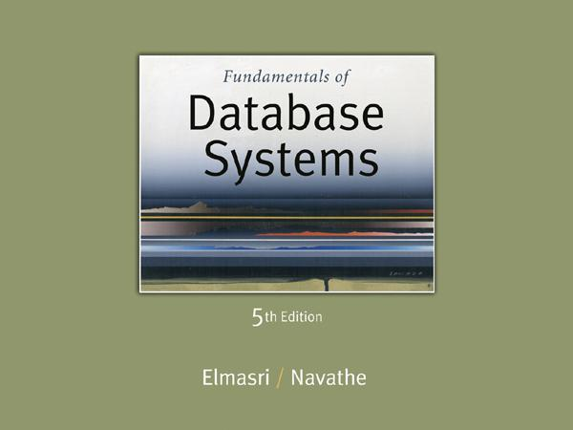

Slide 2
Algorithms for SELECT and JOIN Operations (8)
Implementing the JOIN Operation:
Join (EQUIJOIN, NATURAL JOIN)
two–way join: a join on two files
e.g. R _{A=B} S
multi-way joins: joins involving more than two files.
e.g. R _{A=B} S _{C=D} T
Examples
(OP6): EMPLOYEE _{DNO=DNUMBER} DEPARTMENT
(OP7): DEPARTMENT _{MGRSSN=SSN} EMPLOYEE

Slide 3
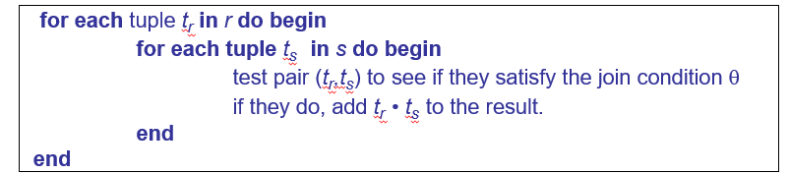
Algorithms for SELECT and JOIN Operations (9)
Implementing the JOIN Operation (contd.):
Methods for implementing joins:
J1 Nested-loop join (brute force):
For each record t in R (outer loop), retrieve every record s from S (inner loop) and test whether the two records satisfy the join condition t[A] = s[B].
r is called the outer relation and s the inner relation of the join.
Requires no indices and can be used with any kind of join condition.
Expensive since it examines every pair of tuples in the two relations.

Slide 4
Algorithms for SELECT and JOIN Operations (9)
J2 Single-loop join (Using an access structure to retrieve the matching records):
If an index (or hash key) exists for one of the two join attributes — say, B of S — retrieve each record t in R, one at a time, and then use the access structure to retrieve directly all matching records s from S that satisfy s[B] = t[A].

Slide 5
Algorithms for SELECT and JOIN Operations (10)
Implementing the JOIN Operation (contd.):
Methods for implementing joins:
J3 Sort-merge join:
If the records of R and S are physically sorted (ordered) by value of the join attributes A and B, respectively, we can implement the join in the most efficient way possible.
Both files are scanned in order of the join attributes, matching the records that have the same values for A and B.
In this method, the records of each file are scanned only once each for matching with the other file—unless both A and B are non-key attributes, in which case the method needs to be modified slightly.

Slide 6
Algorithms for SELECT and JOIN Operations (11)
Implementing the JOIN Operation (contd.):
Methods for implementing joins:
J4 Hash-join:
The records of files R and S are both hashed to the same hash file, using the same hashing function on the join attributes A of R and B of S as hash keys.
A single pass through the file with fewer records (say, R) hashes its records to the hash file buckets.
A single pass through the other file (S) then hashes each of its records to the appropriate bucket, where the record is combined with all matching records from R.

Slide 7
Algorithms for SELECT and JOIN Operations (14)
Implementing the JOIN Operation (contd.):
Factors affecting JOIN performance
Available buffer space
Join selection factor
Choice of inner VS outer relation

Slide 8
Algorithms for SELECT and JOIN Operations (15)
Implementing the JOIN Operation (contd.):
Other types of JOIN algorithms
Partition hash join
Partitioning phase:
Each file (R and S) is first partitioned into M partitions using a partitioning hash function on the join attributes:
R1 , R2 , R3 , ...... Rm and S1 , S2 , S3 , ...... Sm
Minimum number of in-memory buffers needed for the partitioning phase: M+1.
A disk sub-file is created per partition to store the tuples for that partition.
Joining or probing phase:
Involves M iterations, one per partitioned file.
Iteration i involves joining partitions Ri and Si.

Slide 9
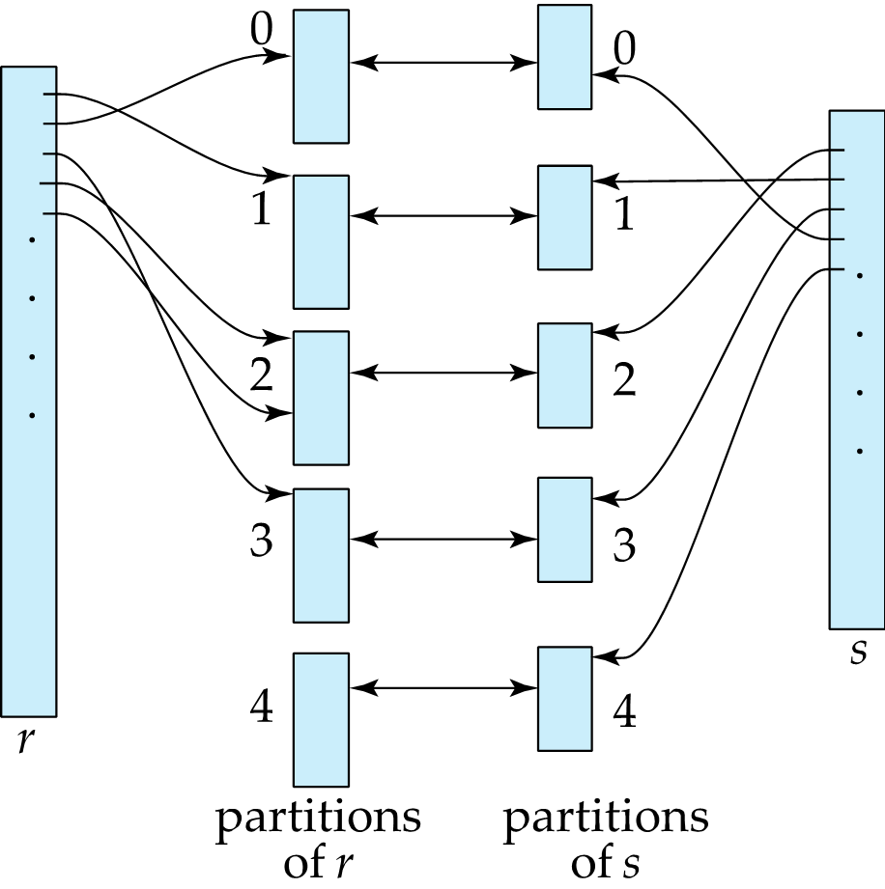
Partition hash join

Slide 10
Algorithms for SELECT and JOIN Operations (16)
Implementing the JOIN Operation (contd.):
Partitioned Hash Join Procedure:
Assume Ri is smaller than Si.
Copy records from Ri into memory buffers.
Read all blocks from Si, one at a time and each record from Si is used to probe for a matching record(s) from partition Si.
Write matching record from Ri after joining to the record from Si into the result file.

Slide 11
Algorithms for SELECT and JOIN Operations (17)
Implementing the JOIN Operation (contd.):
Cost analysis of partition hash join:
Reading and writing each record from R and S during the partitioning phase: (b_{R} + b_{S}), (b_{R} + b_{S})
Reading each record during the joining phase: (b_{R} + b_{S})
Writing the result of join: b_{RES}
Total Cost:
3* (b_{R} + b_{S}) + b_{RES}

Slide 12
Algorithms for SELECT and JOIN Operations (18)
Implementing the JOIN Operation (contd.):
Hybrid hash join:
Same as partitioned hash join except:
Joining phase of one of the partitions is included during the partitioning phase.
Partitioning phase:
Allocate buffers for smaller relation- one block for each of the M-1 partitions, remaining blocks to partition 1.
Repeat for the larger relation in the pass through S.)
Joining phase:
M-1 iterations are needed for the partitions R2 , R3 , R4 , ......Rm and S2 , S3 , S4 , ......Sm. R1 and S1 are joined during the partitioning of S1, and results of joining R1 and S1 are already written to the disk by the end of partitioning phase.

